Slide 1

Customer Shopping Behavior Analysis
Strategic insights from 3,900 transactions across diverse product categories to drive business growth.

Slide 2

Dataset Overview
Key Metrics
Core Features
3,900 Total Rows
Demographics, purchase details, and behavioral tracking including shipping and ratings.
18 Data Columns
50 Unique Locations

Slide 3

Data Preparation & Cleaning
Python Processing
Imputation
Integration
Data loading and initial exploration using Pandas.
Filled 37 missing review ratings using category medians.
Standardized columns to snake_case and loaded into PostgreSQL.

Slide 4
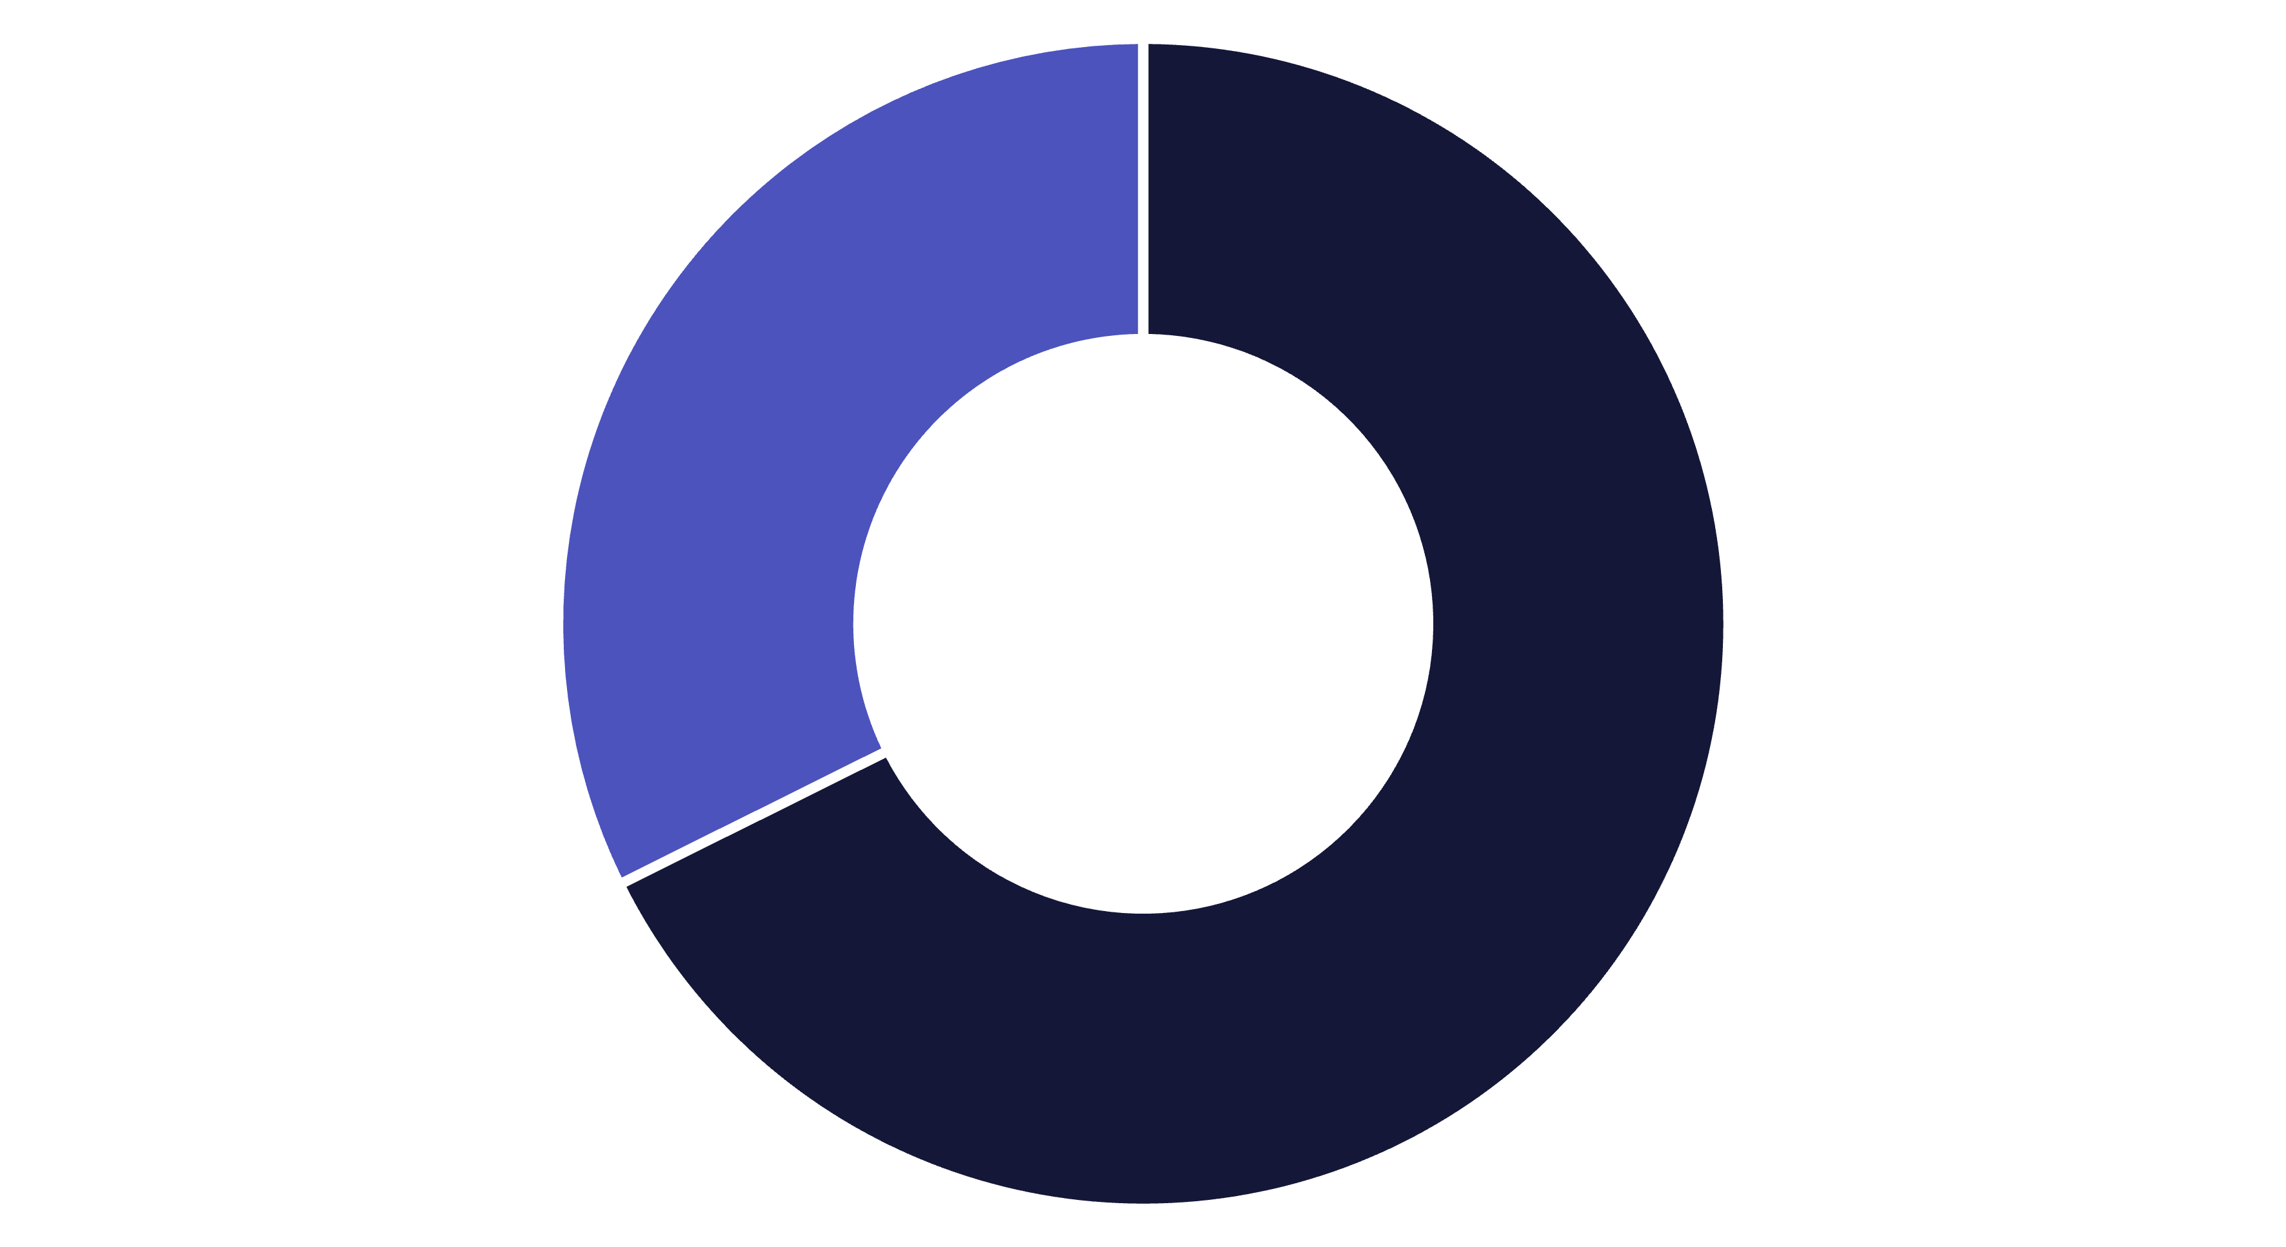
Revenue by Gender
Male
Female
Male customers contribute significantly higher total revenue compared to female customers.

Slide 5



Top Rated Products
3.86
3.84
Gloves
Sandals
3.82
3.80
Boots
Hats

Slide 6
Subscription & Loyalty Analysis
Customer Segments
Subscription Status
Loyal: 3,116
1,053 Subscribers vs 2,847 Non-Subscribers. Average spend is nearly identical (~$59).
Returning: 701
New: 83

Slide 7
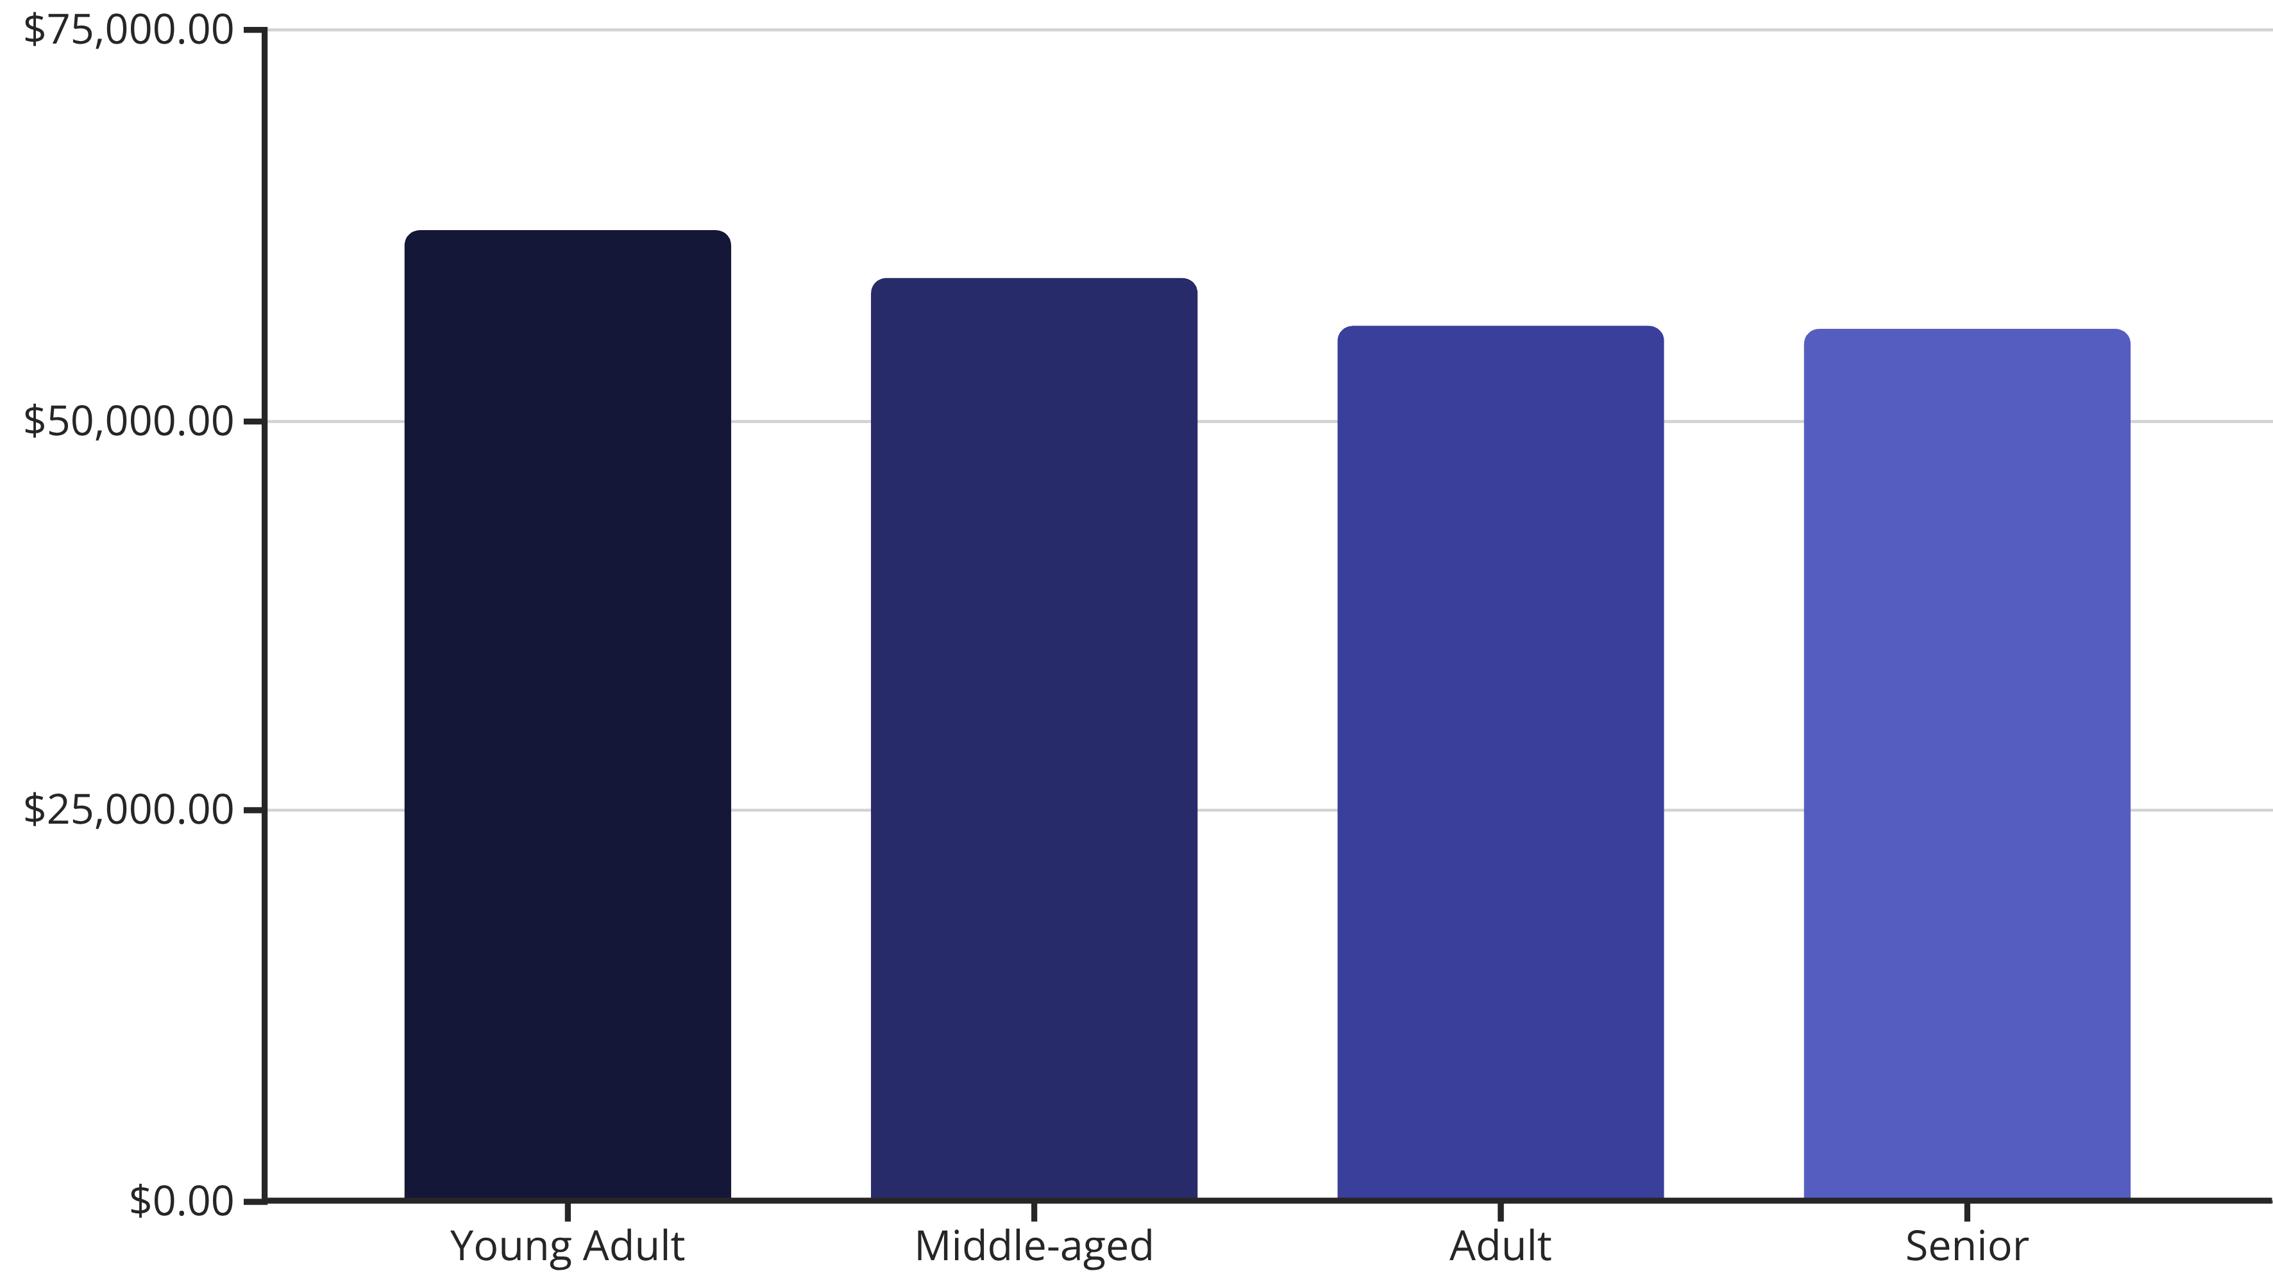
Revenue by Age Group
Young adults represent the highest revenue-generating segment for the business.

Slide 8
Category Leaders
Category
Top Item
Orders
Clothing
Blouse / Pants
171
Accessories
Jewelry
171
Outerwear
Jacket
163
Footwear
Sandals
160

Slide 9
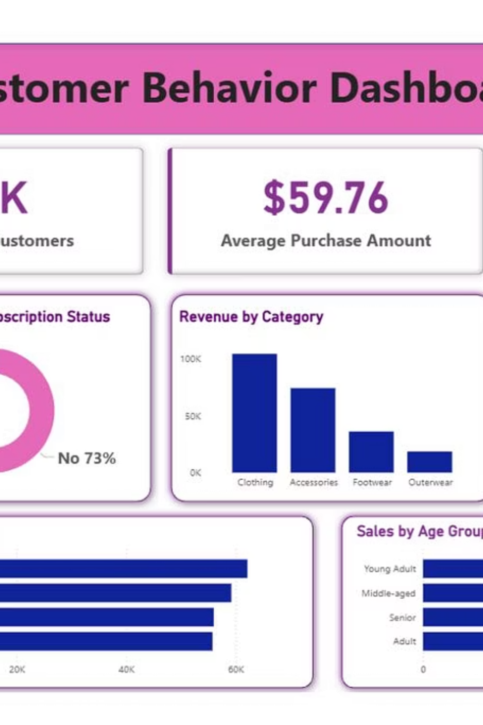
Interactive Dashboard
Comprehensive visual overview of sales, shipping preferences, and customer distribution.

Slide 10

Strategic Recommendations
Boost Subscriptions
Loyalty Programs
Targeted Marketing
Promote exclusive benefits to convert the 2,847 non-subscribers.
Reward repeat buyers to solidify the "Loyal" segment.
Focus on high-revenue Young Adults and Express Shipping users.
Key Takeaway: Balance discount policies to maintain margins while highlighting top-rated products.

